Slide 1



AUTONOMOUS SHIPPING Sprint 9
Jasper Vlaar, Jelte Molenaar, Job Vink, Michiel van Soest en Martin de Rijke

Slide 2
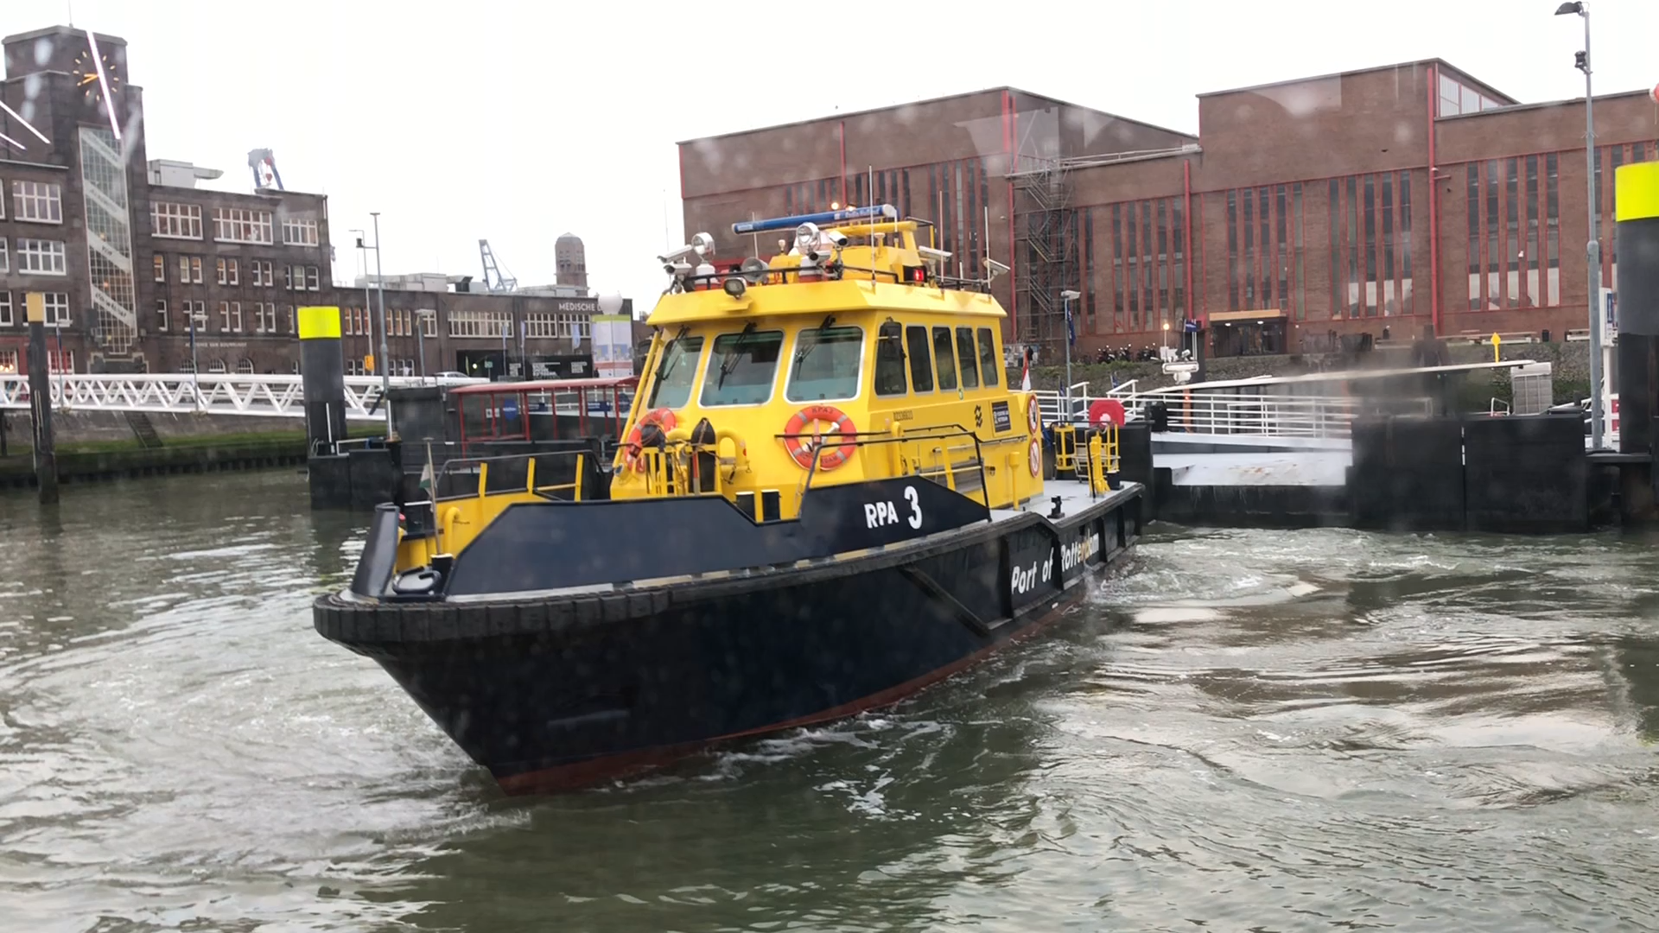
Autonomous shipping

Slide 3
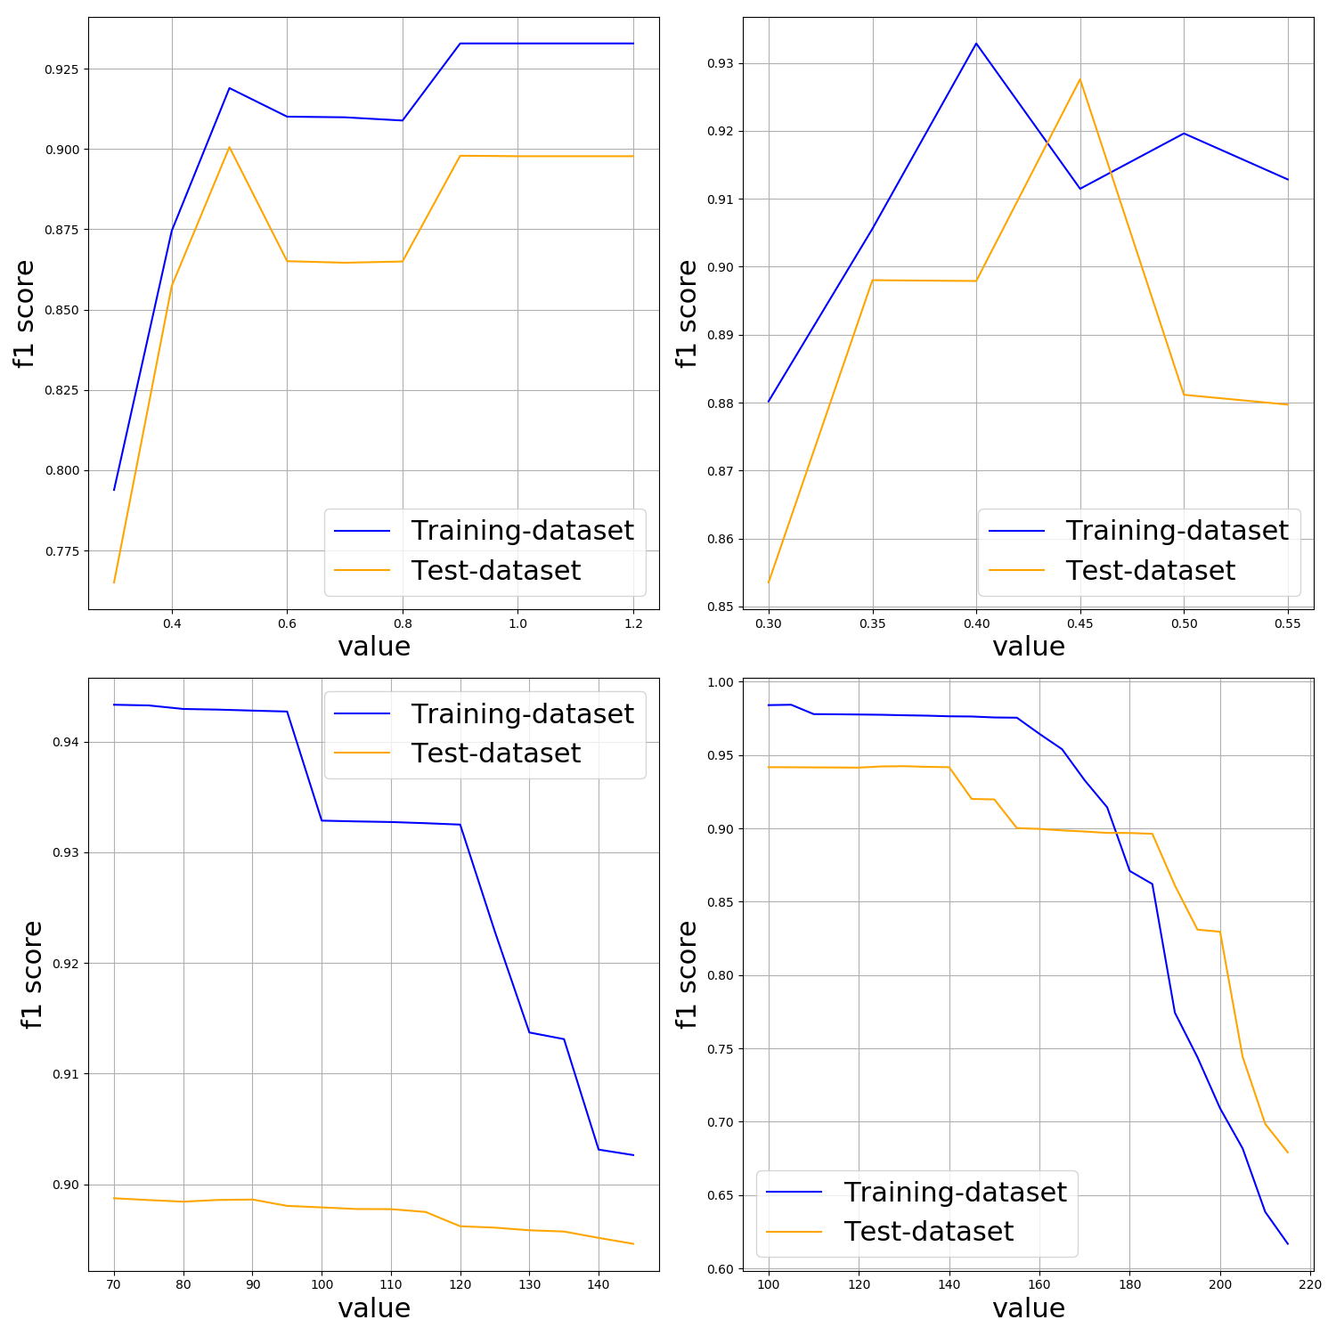
Hyperparametering
Retrained hyperparameters
Added test-dataset

Slide 4
Paper/Portfolio
Paper almost finished:
Summary
Results
Conclusions

